Slide 1



Financial Crime Analysis
View in Power BI
Last data refresh:
6/1/2022 9:33:24 AM UTC
Downloaded at:
6/1/2022 9:34:10 AM UTC

Slide 2
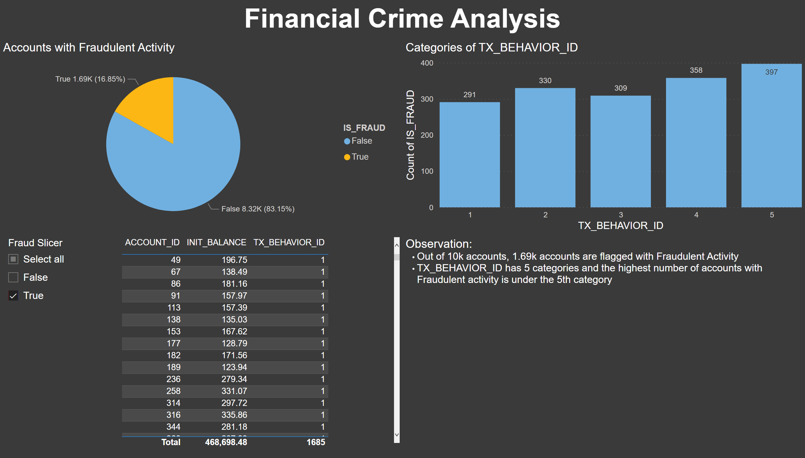
Part 1
Notes:
textbox
No alt text provided
textbox
No alt text provided
Accounts with Fraudulent Activity
No alt text provided
Categories of TX_BEHAVIOR_ID
No alt text provided
Initial Balance of Accounts with Fraudulent Activity
No alt text provided
slicer
No alt text provided

Slide 3
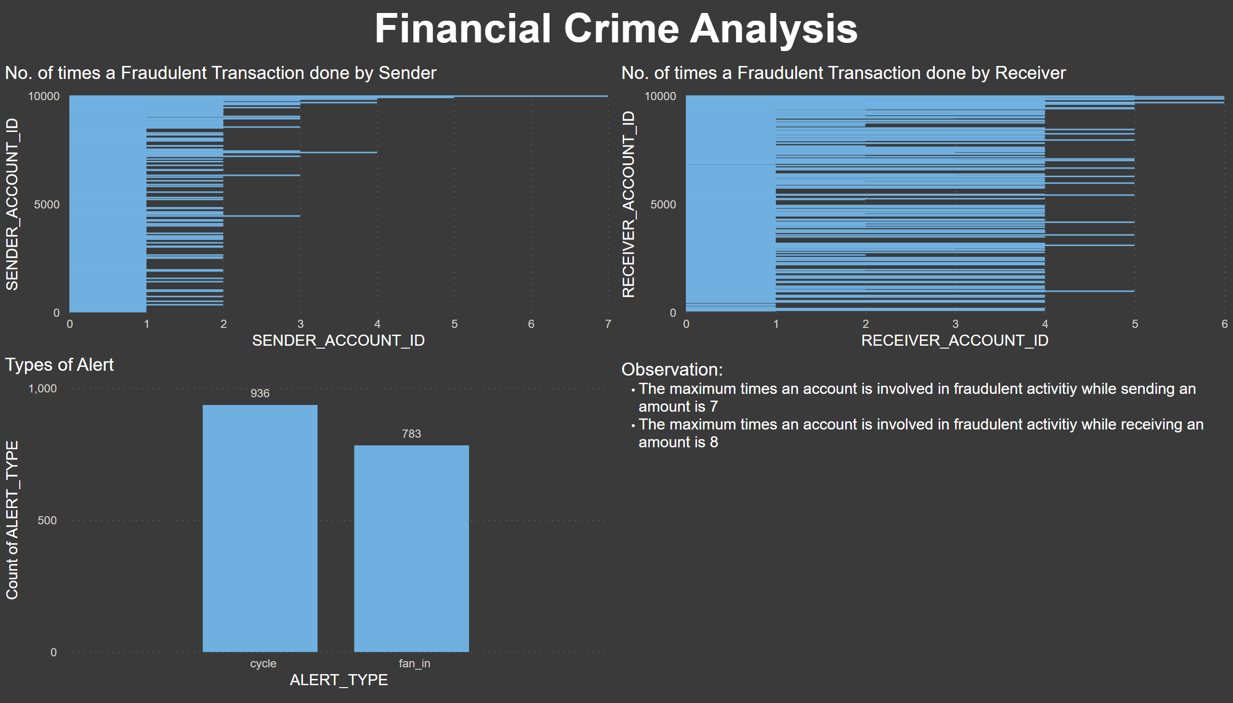
Part 2
Notes:
Types of Alert
No alt text provided
No. of times a Fraudulent Transaction done by Sender
No alt text provided
No. of times a Fraudulent Transaction done by Receiver
No alt text provided
textbox
No alt text provided
textbox
No alt text provided

Slide 4
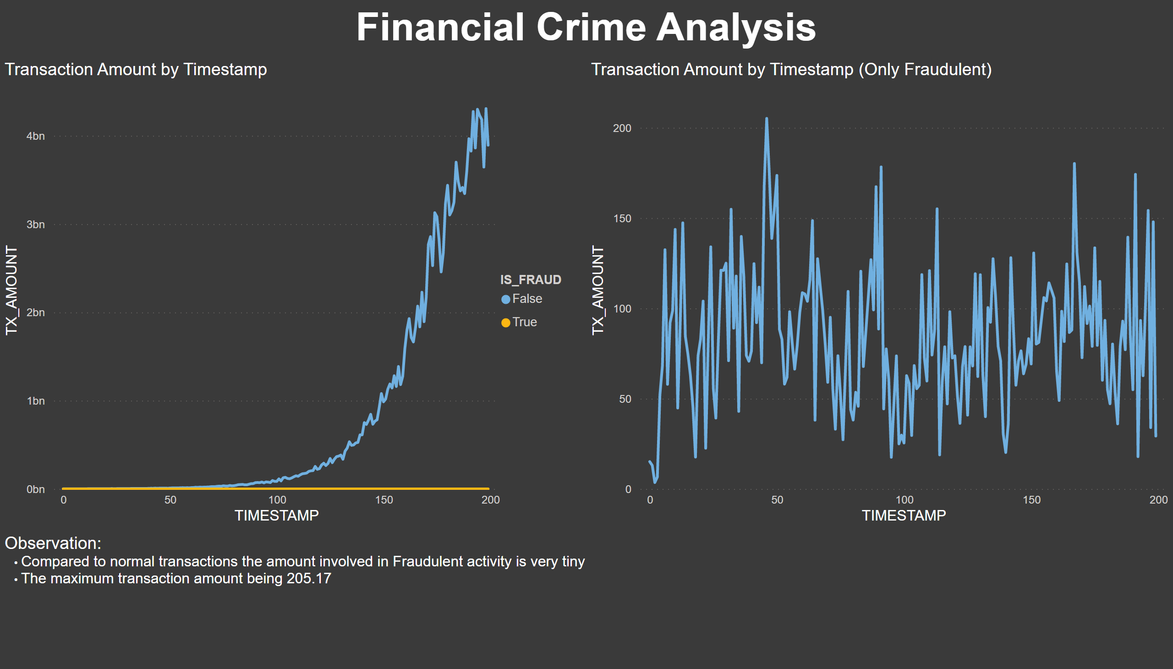
Part 3
Notes:
textbox
No alt text provided
textbox
No alt text provided
Transaction Amount by Timestamp
No alt text provided
Transaction Amount by Timestamp (Only Fraudulent)
No alt text provided

Slide 5
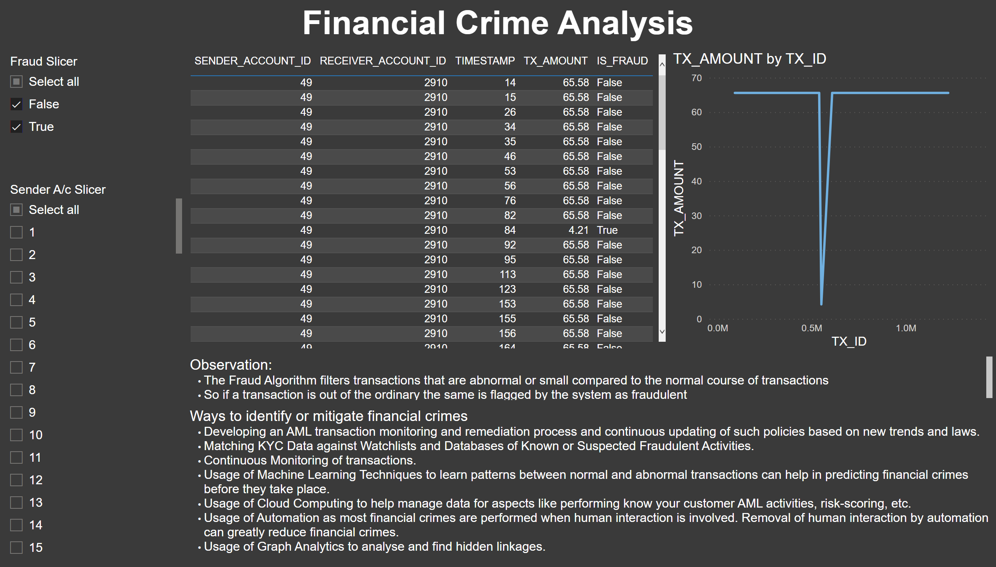
Part 4
Notes:
textbox
No alt text provided
tableEx
No alt text provided
slicer
No alt text provided
slicer
No alt text provided
lineChart
No alt text provided
textbox
No alt text provided
textbox
No alt text provided

